Slide 1

Water-Point Monitor
IoT-Based Smart Village Water Point Uptime Monitoring System

Slide 2


Problem & Solution
The Problem
Our Solution
Manual monitoring of village water points.
WaterPoint Monitor uses an ESP32-based IoT device to monitor water flow, detect faults automatically, send data to a centralized server, and display live information on a smart dashboard.
Delayed fault reporting.
Significant water wastage.
Long maintenance times.
No real-time monitoring available.

Slide 3







System Architecture
Flow Sensor (Potentiometer)
ESP32 Microcontroller
Wi-Fi / HTTP POST
Node.js + Express API
SQLite Database
React Dashboard

Slide 4






Technologies Used
Frontend
Backend
React.js • Bootstrap • Chart.js
Node.js • Express.js
Dynamic, component-based user interface for real-time visualization.
Fast, scalable server architecture with robust RESTful API routing.
Database
IoT & Hardware
SQLite
ESP32 • Wokwi • Arduino IDE • REST API
Lightweight, fast, relational data storage for point tracking and logs.
Low-cost edge processing, circuit simulation, and direct cloud communication.

Slide 5
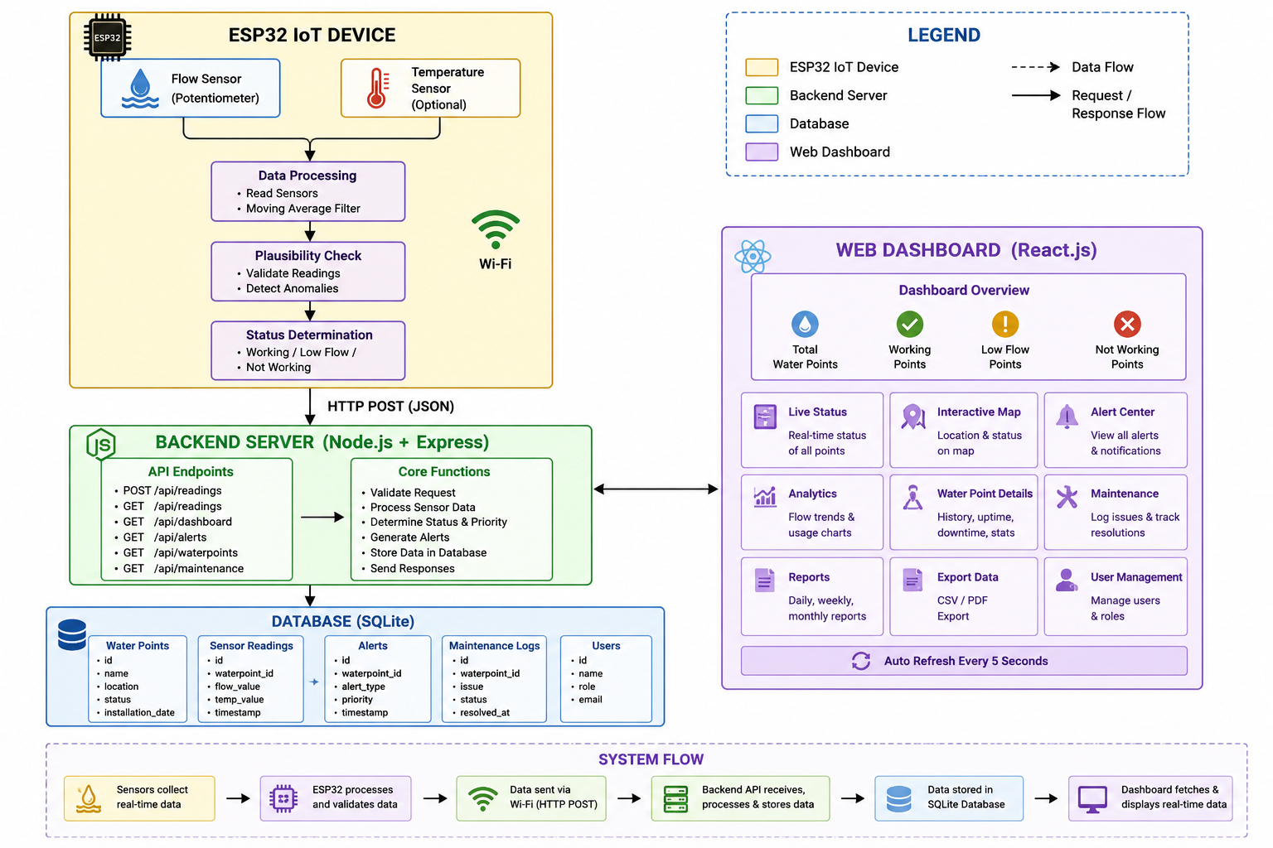
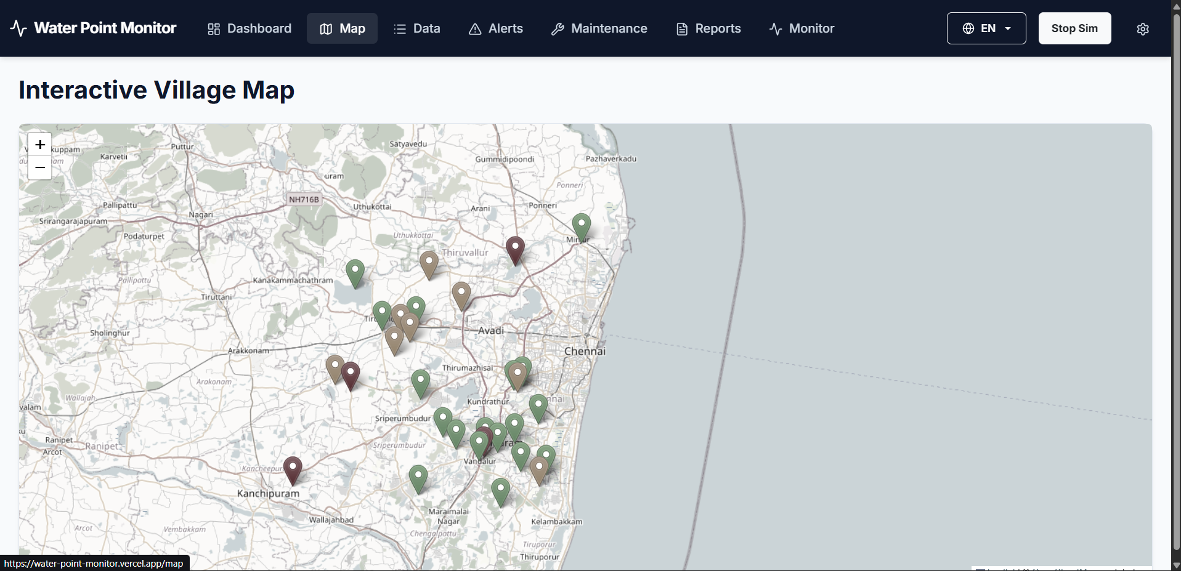
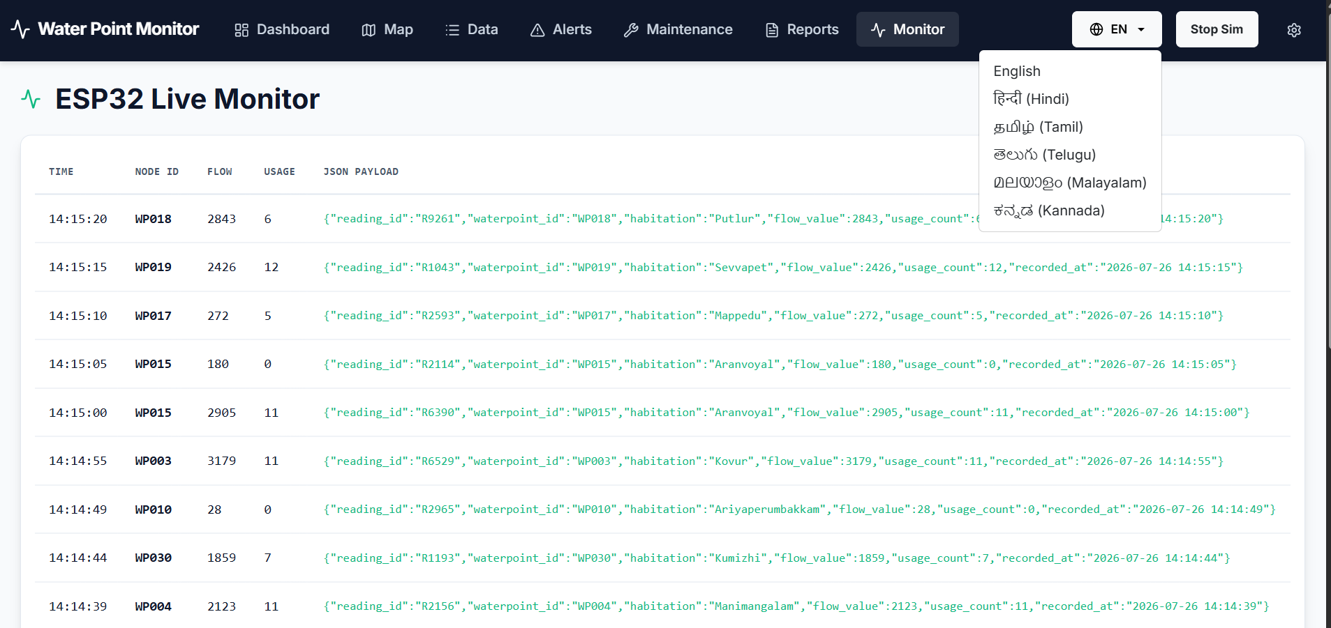
Working Process
Working Video DEMO LINK
Deployment Link

Slide 6

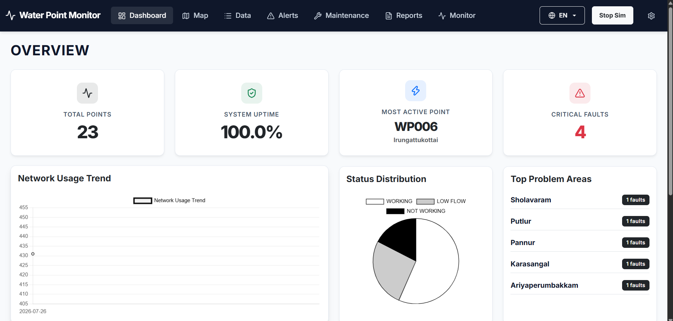

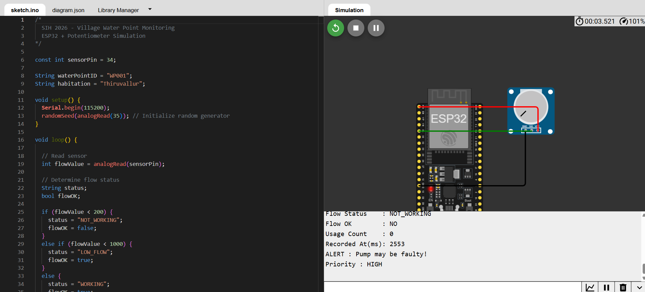
Features & Demo
Dashboard Capabilities
Live Water Point Status Mapping
Real-time Flow Value Tracking
Auto-categorization: Working / Low Flow / Not Working
Historical Analytics Charts
Instant Alert Notifications
Digital Maintenance Logs

Slide 7




Advantages & Future Scope
Advantages
Future Scope
Real-time Monitoring
Real Physical Flow Sensors
Automatic Fault Detection
GSM/4G & LoRa/NB-IoT Connectivity
Low Cost & IoT-Based
Dedicated Mobile Application
Easy Maintenance Routing
SMS Alerts for Offline Areas
Highly Scalable Architecture
AI-based Predictive Maintenance
Village Friendly & Accessible
Full Cloud Deployment
Questions?
Thank You
github.com/antony-jude/WaterPoint-Monitor

